Slide 1
Confidence Thresholding in Self-Training: A Tutorial
Semi-Supervised Learning

Slide 2
What We Cover:
Topic We Cover
What is Self-Training?
Dataset Visualization
Key Observations from the Dataset
Initial Model Training
Introducing Confidence Thresholding
Retraining the Model
Results and Analysis
Conclusion
References

Slide 3
Topic We Cover
In machine learning, one of the significant challenges is learning from limited labeled data. Semi-supervised learning provides a solution by leveraging unlabeled data alongside labeled data. Among semi-supervised methods, self-training is widely recognized for its simplicity and effectiveness. However, self-training can suffer from noisy pseudo-labels, which degrade model performance. This tutorial aims to address this issue by demonstrating the use of confidence thresholding, a technique that filters pseudo-labels based on their confidence levels, to improve self-training outcomes.
This tutorial is structured to:
Provide an overview of self-training and semi-supervised learning.
Demonstrate confidence thresholding in self-training using visual explanations.
Analyze the results and offer practical insights into applying this method.

Slide 4
What is Self-Training?
Definition of Semi-Supervised Learning
Semi-supervised learning is a type of machine learning that leverages a small amount of labeled data and a large amount of unlabeled data to improve model performance. It bridges the gap between supervised and unsupervised learning (Zhu, 2008).

Slide 5
What is Self-Training?
Definition of Self-Training
Self-training is an iterative semi-supervised learning method where a model predicts pseudo-labels for unlabeled data and retrains itself using both labeled and high-confidence pseudo-labeled data (Lee, 2013).

Slide 6
What is Self-Training?
Why Self-Training?
Self-training is simple, flexible, and can work with most supervised learning models. However, its success depends on the quality of pseudo-labels, which can be enhanced through techniques like confidence thresholding.

Slide 7
What is Self-Training?
Semi-Supervised Learning
Combines small labeled datasets and large unlabeled datasets.
Bridges the gap between supervised and unsupervised learning (Zhu, 2008).
Self-Training
Iterative process:
Train a model on labeled data.
Predict pseudo-labels for unlabeled data.
Use high-confidence pseudo-labels to retrain.
Simple and flexible but depends on pseudo-label quality (Lee, 2013).

Slide 8
Dataset Visualization
Setup
Small percentage of labeled samples.
Large pool of unlabeled samples.
Goal: Use unlabeled data to enhance model performance.
Characteristics:
Labeled Data: Ground truth for training.
Unlabeled Data: Will receive pseudo-labels during training.
Visualizing the Dataset
Labeled Data: Points in red/blue (different classes).
Unlabeled Data: Gray points.

Slide 9
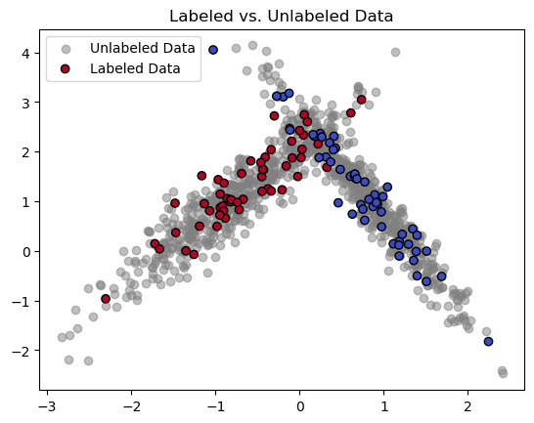
Dataset Visualization
Code
# Create a synthetic dataset
X, y = make_classification(n_samples=1000, n_features=3, n_informative=2, n_redundant=1, n_classes=2, n_clusters_per_class=1, random_state=42)
# Use only the first two features for visualization
X_visual = X[:, :2]
# Split data into labeled and unlabeled subsets
labeled_mask = np.random.choice([True, False], size=1000, p=[0.1, 0.9])
X_labeled = X[labeled_mask]
y_labeled = y[labeled_mask]
X_unlabeled = X[~labeled_mask]
y_unlabeled = y[~labeled_mask]
# Visualize the labeled and unlabeled data
plt.scatter(X_unlabeled[:, 0], X_unlabeled[:, 1], c='gray', label='Unlabeled Data', alpha=0.5)
plt.scatter(X_labeled[:, 0], X_labeled[:, 1], c=y_labeled, cmap='coolwarm', label='Labeled Data', edgecolor='k')
plt.title('Labeled vs. Unlabeled Data')
plt.legend()
plt.show()
Plot

Slide 10
Key Observations from the Dataset
Labeled data:
Sparse and covers limited regions.
Used to train the initial model.
Unlabeled data:
Broader distribution.
Key source for pseudo-labeling.
Visual shows the potential for improvement with pseudo-labeling.

Slide 11
Initial Model Training
Objective:
Train a model using only labeled data.
Use this model to generate predictions for the unlabeled data.
Process:
Train Model:
Use labeled data to create an initial classifier.
Predict on Unlabeled Data:
Use the model to predict labels for the unlabeled samples.
Limitations:
Sparse labeled data leads to less generalizable decision boundaries.

Slide 12
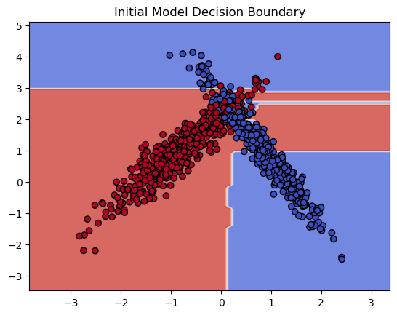
Initial Model Training
Visualizing the Decision Boundary:
Initial decision boundaries are based on limited labeled data.
This often results in inaccurate or uncertain regions.
Observations:
The initial decision boundary is overly simplistic.
Limited labeled data causes poor generalization to the unlabeled data.

Slide 13
Introducing Confidence Thresholding
Objective:
Address the issue of noisy pseudo-labels.
Use confidence thresholding to filter out low-confidence predictions.
What is Confidence Thresholding?
A method to ensure only reliable pseudo-labels are used.
Process:
The model assigns confidence scores to its predictions.
Predictions with confidence scores above a defined threshold are retained.
Low-confidence predictions are discarded.

Slide 14
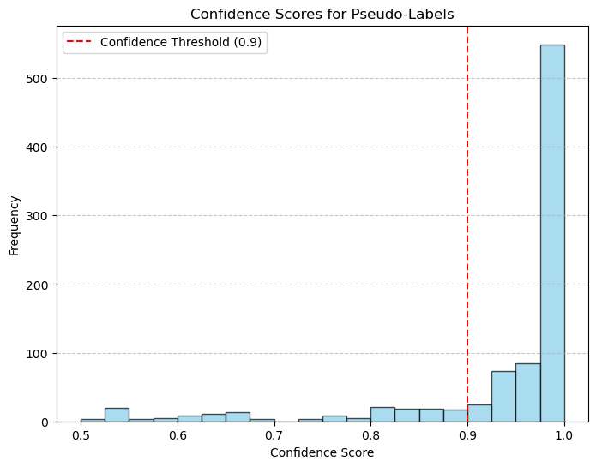
Introducing Confidence Thresholding
Benefits:
Reduces the impact of noisy labels.
Improves the quality of retraining data.
Visualizing Confidence Scores:
A histogram of confidence scores for unlabeled data shows the distribution.
The threshold (e.g., 0.9) separates high-confidence predictions.

Slide 15
Retraining the Model
Objective:
Combine high-confidence pseudo-labeled data with labeled data.
Retrain the model to improve decision boundaries.
Process:
Select High-Confidence Data:
Filter pseudo-labels based on confidence scores.
Merge them with labeled data.
Retrain the Model:
Use the combined dataset to refine the decision boundary.

Slide 16
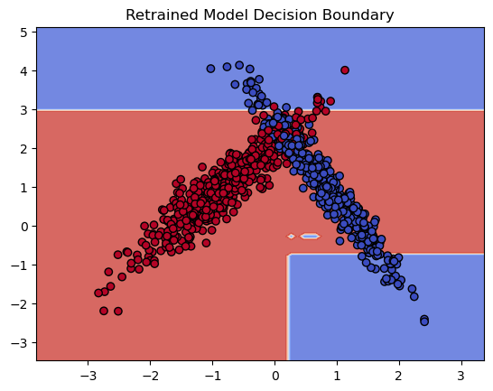
Retraining the Model
Visualizing the Updated Decision Boundary:
Retraining adjusts the decision boundary to better fit the data.
High-confidence pseudo-labeled data helps expand the boundary into previously uncertain regions.
Observations:
The updated decision boundary is more accurate.
Incorporating high-confidence pseudo-labeled data reduces uncertainty in classification regions.

Slide 17
Conclusion
Key Insights:
Self-Training:
A powerful semi-supervised learning technique.
Iteratively improves performance using pseudo-labeled data.
Confidence Thresholding:
Ensures the reliability of pseudo-labels.
Balances between quantity (lower threshold) and quality (higher threshold).
Practical Implications:
Works best with datasets where labeled data is scarce but informative.

Slide 18
Conclusion
Recommendations:
Experiment with different confidence thresholds.
Monitor the distribution of pseudo-labels to avoid imbalance.
Combine confidence thresholding with other semi-supervised methods for enhanced performance.

Slide 19
References
Lee, D.H. (2013). Pseudo-Label: The Simple and Efficient Semi-Supervised Learning Method. arXiv preprint arXiv:1301.0796. Available at: https://arxiv.org/abs/1301.0796.
Zhu, X. (2008). Semi-Supervised Learning Literature Survey. University of Wisconsin-Madison. Available at: https://pages.cs.wisc.edu/~jerryzhu/pub/ssl_survey.pdf.
Scikit-learn Documentation (2023). SelfTrainingClassifier. Available at: https://scikit-learn.org/1.5/modules/generated/sklearn.semi_supervised.SelfTrainingClassifier.html

